Slide 1



Apache CXF, Tika and Lucene The power of search the JAX-RS way
Andriy Redko
Notes:
Welcome everyone to my talk. This talk is about a quick and easy way of integrating full-fledged search capabilities into typical JAX-RS applications, built on top of excellent Apache CXF framework. This talk assumes that you have some basic knowledge of JAX-RS services and Apache Lucene library.

Slide 2
About myself
Passionate Software Developer since 1999
On Java since 2006
Currently employed by AppDirect in Montreal
Contributing to Apache CXF project since 2013
http://aredko.blogspot.ca/
https://github.com/reta

Slide 3
What this talk is about …
REST web APIs are everywhere
JSR-339 / JAX-RS 2.0 is a standard way to build RESTful web services on JVM
Search/Filtering capabilities in one form or another are required by most of web APIs out there
So why not to bundle search/filtering into REST apps in generic, easy to use way?
Notes:
We are going to talk about REST APIs in Java world, more specifically about applications which are using JAX-RS 2.0 / JSR-339 as the foundation. Nowadays, it is quite rare to encounter an API which does not support any kind of search or filtering functionality over the resources it manages (for example, users, customers, invoices, companies, …). For sure, the needs of every API are quite domain specific, however in the essence it narrows down to very similar search / filtering implementations. Why not to come up with a generic, JAX-RS friendly implementation of this feature so any API could immediately benefit from that?

Slide 4
Meet Apache CXF
Apache CXF is very popular open source framework to develop services and web APIs on JVM platform
The latest 3.0 release is (as complete as possible) JAX-RS 2.0 compliant implementation
Vibrant community, complete documentation and plenty of examples make it a great choice
Notes:
This is where Apache CXF comes on the rescue. Apache CXF is as complete as possible JAX-RS 2.0 compliant but because Apache has no access to TCK, the “full compliance” cannot be claimed. The project is very mature and is actively evolving, adding more and more features with every single release.

Slide 5
Apache CXF Search Extension (I)
Very simple concept build around customizable _s / _search query parameter
At the moment, supports Feed Item Query Language (FIQL) expressions and OData 2.0 URI filter expressions
http://my.host:9000/api/people?_search=
"firstName eq 'Bob' and age gt 35"
Notes:
Apache CXF search extension is a generic search feature implementation, provided and exposed in JAX-RS friendly way. It is build around additional query string parameter which contains an expressions to perform the search over REST resources. Currently, the two expression dialects are support: FIQL and OData 2.0 URI filters. Here is a quick example to taste.

Slide 6
FIQL
The Feed Item Query Language
IETF draft submitted by M. Nottingham on December 12, 2007 https://tools.ietf.org/html/draft-nottingham-atompub-fiql-00
Fully supported by Apache CXF
_search=firstName==Bob;age=gt=35
Notes:
Few words about FIQL. It is quite simple and uses the ‘equal’ sign to denote operators, ‘;’ as and condition, ‘,’ as or condition and brackets to group expressions.

Slide 7
OData 2.0
Uses OData URI $filter system query option http://www.odata.org/documentation/odata-version-2-0/uri-conventions
Built on top of Apache Olingo and its FilterParser implementation
Only subset of the operators is supported (matching the FIQL expressions set)
_search="firstName eq 'Bob' and age gt 35"
Notes:
OData is a very well known and widely used RESTful data access protocol (current version is 4). It has a lot of things to offer, but one of the very interesting features is URI query options (like $orderby, $filter, …). Apache CXF search extension supports $filter query option which allows to use subset of OData filtering expressions and operators. At the moment, OData 2.0 version is supported however OData 4.0 is on the list as well.

Slide 8
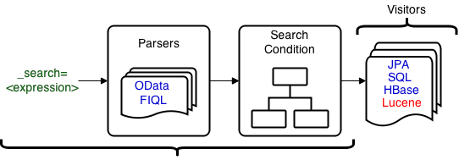
Apache CXF Search Extension (II)
Under the hood …
@GET
@Produces( { MediaType.APPLICATION_JSON } )
public Response search(@Context SearchContext context) { ... }

Slide 9
Apache Lucene In Nutshell
Leading, battle-tested, high-performance, full-featured text search engine
Written purely in Java
Foundation of many specialized and general-purpose search solutions (including Solr and Elastic Search)
Current major release branch is 5.x
Notes:
Apache Lucene is the search library for JVM-based applications and services.

Slide 10
Apache CXF Search Extension (III)
LuceneQueryVisitor maps the search/filter expression into Apache Lucene query
Uses QueryBuilder and is analyzer-aware (means stemming, stop words, lower case, … apply if configured)
Apache Lucene 4.7+ is required (4.9+ recommended)
Subset of Apache Lucene queries is supported (many improvements in upcoming 3.1 release)
Notes:
Knowing how good and popular Apache Lucene, it comes with no surprise that Apache CXF search extension has a visitor implementation which converts the search / filter expression (FIQL, OData) into full-fledge Apache Lucene query. There are so many different types of queries which Lucene supports that only a subset is being support by the visitor. We are going to talk about all those queries shortly.

Slide 11
Lucene Query Visitor
Search conditions are type-safe but also support key/value map (aka SearchBean)
@GET
@Produces( { MediaType.APPLICATION_JSON } )
public Response search(@Context SearchContext context) {
final LuceneQueryVisitor< SearchBean > visitor =
new LuceneQueryVisitor< SearchBean >(analyzer);
visitor.visit(context.getCondition(SearchBean.class));
final IndexReader reader = ...;
final IndexSearcher searcher = new IndexSearcher(reader);
final Query query = visitor.getQuery();
final TopDocs topDocs = searcher.search(query, 10);
...
}
Notes:
The search conditions implementation is type-safe and can be applied to arbitrary classes and collections (internally the respective property values are retrieved through reflection calls). But regular key/value map (SearchBean) is also supported which makes it very easy to project the search conditions to Lucene queries, JPA criteria, SQL, HBASE filters, … without creating tons of supplementary classes.

Slide 12
Supported Lucene Queries
TermQuery
PhraseQuery
WildcardQuery
NumericRangeQuery (int / long / double / float)
TermRangeQuery (date)
BooleanQuery (or / and)
Notes:
Apache Lucene has a very rich set of query types and their compositions. But Apache CXF search extension uses the subset of the most commonly used ones which nonetheless is quite enough to cover the demands of many applications. On the next couple of slides we are going to see the examples of how FIQL/OData filters are mapped into one of those queries.

Slide 13

TermQuery Example
_search=firstName==Bob
_search="firstName eq 'Bob'"
FIQL
OData
firstName:bob
* the term is lower-cased (analyzer dependent)
Notes:
TermQuery is the most basic one and looks for documents which contain the single term. In this example, the StandardAnalyzer has been used which leads to conversion of the term into lower case while building Apache Lucene query.

Slide 14
PhraseQuery Example
_search=content=='Lucene in Action'
_search="content eq 'Lucene in Action'"
FIQL
OData
content:"lucene ? action"
* in is typically a stopword and is replaced by ?
Notes:
PhraseQuery is somewhat similar to TermQuery but instead of single term it uses a phrase as a search criteria. In this example, the StandardAnalyzer has been used which leads to stop word elimination (and lower-casing) while building Apache Lucene query.

Slide 15
WildcardQuery Example
_search=firstName==Bo*
_search="firstName eq 'Bo*'"
FIQL
OData
firstName:Bo*
Notes:
WildcardQuery searches by partial matches (leading or trailing wildcards). In contrast to other types of queries, they are build “as-is” (analyzer independent) and could be really inefficient.

Slide 16
NumericRangeQuery Example
_search=age=gt=35
_search= "age gt 35"
FIQL
OData
age:{35 TO *}
* the type of age property should be numeric
visitor.setPrimitiveFieldTypeMap(singletonMap("age", Integer.class))
Notes:
NumericRangeQuery is used to perform efficient search for numeric field ranges. As LuceneQueryVisitor is generic and does not have the intrinsic knowledge about types of properties used in FIQL/OData filters, it needs to be hinted about numeric nature and exact types of those. Luckly, it is very easy to do using primitiveFieldTypeMap.

Slide 17
TermRangeQuery Example
_search=modified=lt=2015-10-25
_search= "modified lt '2015-10-25'"
FIQL
OData
modified:{* TO 20151025040000000}
* the type of modified property should be date
visitor.setPrimitiveFieldTypeMap(singletonMap(“modified", Date.class))
Notes:
Similarly to NumericRangeQuery, TermRangeQuery is used to perform efficient search across term ranges. It is currently used to search the date fields. The LuceneQueryVisitor also needs to be hinted about temporal nature of the properties using primitiveFieldTypeMap.

Slide 18
BooleanQuery Example
_search=firstName==Bob;age=gt=35
_search= "firstName eq 'Bob' and
age gt 35"
FIQL
OData
+firstName:bob +age:{35 TO *}
Notes:
BooleanQuery is the compositional one, which is used to combine other queries with and / or conditions.

Slide 19
From “How …” to “What …”
Files are still the most widespread source of valuable data
However, most of file formats are either binary (*.pdf, *.doc, …) or use some kind of markup (*.html, *.xml, *.md, …)
It makes the search a difficult problem as the raw text has to be extracted and only then indexed / searched against
Notes:
So far we talked about search, different types of queries and their combination. But every search query should be run against the index which is built using the real data. We are switching gears a bit from the “How to search …” topic to “What data we are going to search against …”.
In general, indexing raw binary files as-is is not very good idea. And though files with markup (like XML, HTML) are human-readable and could be indexed as-is, they introduce a lot of noise (tags) which should better be removed before polluting the index.

Slide 20
Apache Tika
Metadata and text extraction engine
Supports myriad of different file formats
Pluggable modules (parsers), include only what you really need
Extremely easy to ramp up and use
Current release branch is 1.7
Notes:
Apache Tika is metadata and text extraction engine. Its features are not limited only by extraction but this is what we are going to look closely at. The list of supported file formats is very impressive. Due to pluggable parser architecture, you are not required to bundle everything, pick the ones you really need now and easily add more later on.

Slide 21
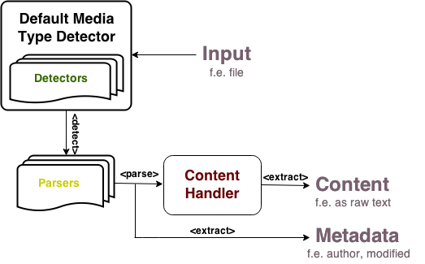
Apache Tika in Nutshell
Notes:
Media Type Detector is a powerful tool which tries its best to detect the real file format. It uses a combination of techniques, not relying solely on file extension. Once the media type is detected, the respective parser could be pin-pointed (if it is available). Most of the parsers extract content (often just raw text) and also metadata (author, modification/creation dates, number of pages, …).

Slide 22
Text Extraction in Apache CXF
Provides generic TikaContentExtractor
Also has specialization for Apache Lucene, TikaLuceneContentExtractor
public class TikaContentExtractor {
public TikaContent extract(final InputStream in) {
...
}
}
public class TikaLuceneContentExtractor {
public Document extract(final InputStream in) {
...
}
}
Notes:
In Apache CXF, the text and metadata extraction using Apache Tika is encapsulated inside TikaContentExtractor class (with TikaContent class being generic representation of raw text and metadata, extracted from the file). TikaLuceneContentExtractor is built on top of TikaContentExtractor and returns prepared Apache Lucene document, which could be indexed right away (however document could be customized/modified before).

Slide 23
And finally, indexing …
The text and metadata extracted from the file could be added straight to Lucene index
final TikaLuceneContentExtractor extractor =
new TikaLuceneContentExtractor(new PDFParser());
final InputStream in = ...;
final Document document = extractor.extract(in);
final IndexWriter writer = ...;
try {
writer.addDocument(document);
writer.commit();
} finally {
writer.close();
}
Notes:
Lastly, with text and metadata extracted and wrapped into Apache Lucene document, it is time to feed it into index. With that, the demo time!

Slide 24
Demo
https://github.com/reta/ApacheConNA2015

Slide 25
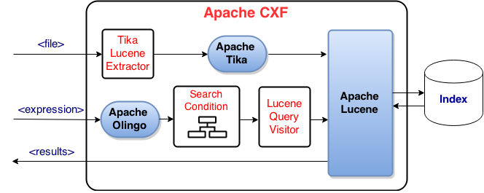
Demo: Gluing All Parts Together …

Slide 26
Apache CXF Search Extension (IV)
Configuring expressions parser
search.parser.class=ODataParser
search.parser=new ODataParser()
Configuring query parameter name
search.query.parameter.name=$filter
Configuring date format
search.date-format=yyyy/MM/dd
Notes:
The search extension is highly configurable. The customizations points include (but not limited to) the parser to be used (ODataParser or FIQLParser), the name of query string parameter (by default _s or _search), date/time format.

Slide 27
Alternatives
ElasticSearch: is a highly scalable open-source full-text search and analytics engine (http://www.elastic.co/)
Apache Solr: highly reliable, scalable and fault tolerant open-source enterprise search platform (http://lucene.apache.org/solr/)
These are dedicated, best in class solutions for solving difficult search problems.
Notes:
ElasticSearch got a lot of traction in last couple of years and has become a very popular choice nowadays as full-fledge and scalable search engine. Apache Solr is an old kind on the block: quite mature and well-known search platform of enterprise level. Both products have a very rich set of features and built on top of Apache Lucene though among the similarities there are differences. Those are best in class solutions, but they come at a cost of maintaining own infrastructure which is not always necessary. Not every application really needs this power.

Slide 28
Useful links
http://cxf.apache.org/docs/jax-rs-search.html
http://lucene.apache.org/
http://tika.apache.org/
http://olingo.apache.org/
http://aredko.blogspot.ca/2014/12/beyond-jax-rs-spec-apache-cxf-search.html
http://jaxenter.com/tutorial-smarter-search-with-fiql-and-apache-cxf-106000.html

Slide 29
Thank you!
Many thanks to Apache Software Foundation and AppDirect for the chance to be here

